Slide 1
(I can't get no) satisfaction
Can SAT-solvers resolve dependency hell?
Notes:
Good afternoon, and thanks for attending SCALE18x! So the title of my talk is ^

Slide 2
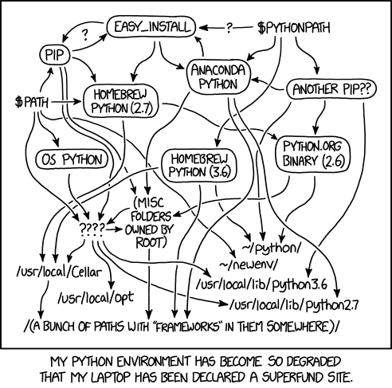
Permanent link to this comic: https://xkcd.com/1987/
Notes:
And before we talk about what is dependency resolution and all the fun therein...

Slide 3
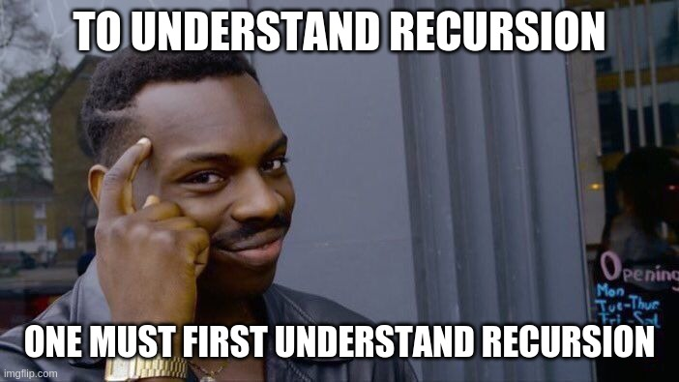
$ ./scale18x_presentation.sh
** (scale18x_presentation) WARNING **: presentation contains recursion.
_
Notes:
A quick warning, (which means you’ll probably ignore this message *pause*)… is that this contains some recursion… and if you don’t understand recursion, don’t worry about...

Slide 4
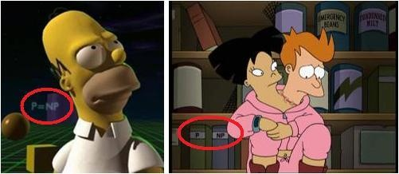
P vs. NP
Notes:
So, before we talk about dependency management,
we’re first going to do a crash course on a classic debate in computer science known as P vs NP…
You may’ve seen P vs NP referenced in an episode of the Simpsons or Futurama...

Slide 5
The 7 Millennium Problems are:
P vs. NP Problem.
Riemann Hypothesis.
Yang–Mills and Mass Gap.
Navier–Stokes Equation.
Hodge Conjecture.
Poincaré Conjecture.
Birch and Swinnerton-Dyer Conjecture.
https://www.claymath.org/millennium-problems
Notes:
You may also recognize it as one of the millennium problems in Mathematics,
You can think of these millenium problems as essentially bug bounties, set by the

Slide 6


Notes:
Clay Mathematics Institute of Cambridge, that awards $1 million dollars for a solution to each of these problems.
One of which, as you may’ve noticed (refer to slide), has already been solved.
Fun fact, the last mathematician to have proved one of these problems declined to accept the award.

Slide 7
Some jargon...
P (polynomial time) is the set of problems that can be solved in polynomial time.
NP (nondeterministic polynomial time) is the set of problems whose solutions can be verified in polynomial time.
Notes:
Some jargon...
P represents polynomial time, which is the set of problems that can be solved in polynomial time.
NP represents nondeterministic polynomial time, which is the set of problems whose solutions can be verified in polynomial time.

Slide 8
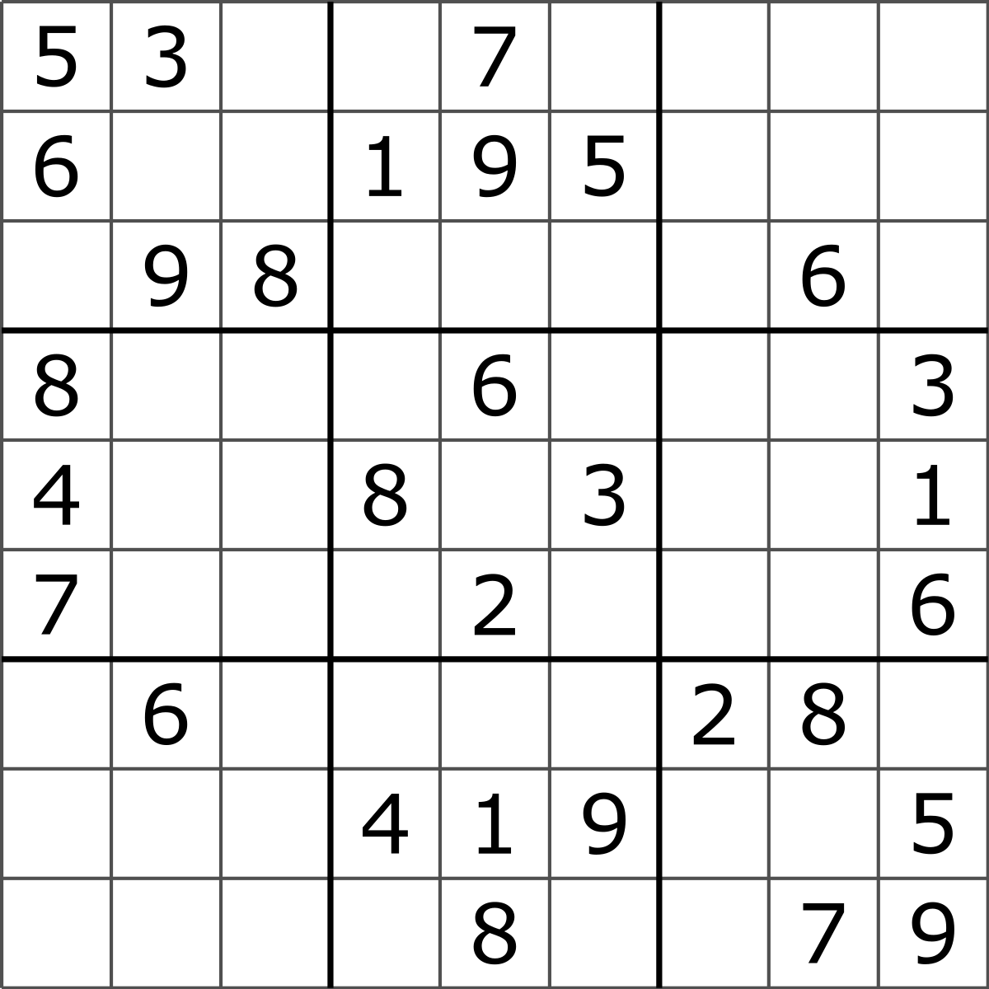
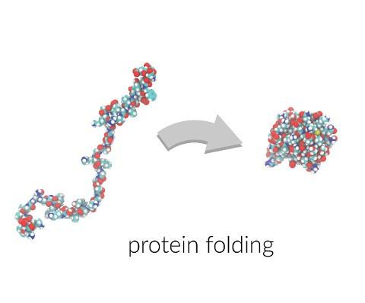

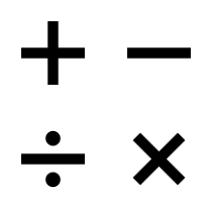
NP-Hard
NP-Complete
NP
Complexity
P vs NP
P
Notes:
For example, P includes problems such as solving a 3x3 rubix cubes, and arithmetic math operations,
Whereas NP problems include the traveling sales, sudoku puzzles, circuit design, protein folding.
And if you reduce the decision problem of NP, in a computability context, it becomes a class called NP-Complete, which is a fancy way of saying, it’s a bit more complex, but still solvable and verifiable…
Interestingly, “P vs. NP” is itself an NP class problem!

Slide 9
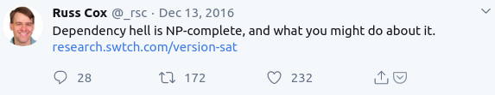
Notes:
So, what does all this P vs NP, and NP-completeness stuff have to do w/ dependency resolution?
Well, it turns out dependency resolution is an NP-complete problem!

Slide 10

Consider the following...
Notes:
Consider the following…

Slide 11
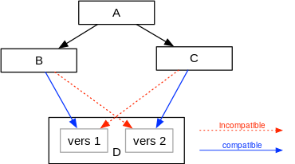
Notes:
Package A depends on package B & C, which both depend on two different version of package D,
this is colloquially referred to as dependency hell.

Slide 12

BUT WAIT SPONGEBOB
WE HAVE TECHNOLOGY
Notes:
But, we have the technology! We can solve NP-complete problems!

Slide 13
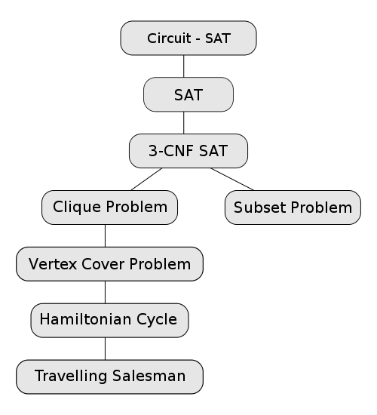
Some NP-Complete Problems, indicating the reductions typically used to prove their NP-completeness
Notes:
We’ve solved this problem in computer science, most notably with a subclass of problem space called boolean satisfiability or SAT for short.

Slide 14

THE PROBLEM IS HUMAN
Notes:
Naturally, the flaw in any computer system is human. Right?
SAT solvers are amazing at their job, but they can only work within the constraints they’re given.
Who sets those constraints? We, the users and developers, do!

Slide 15
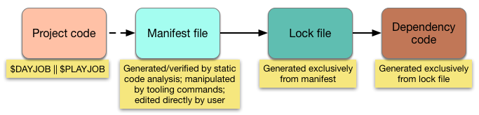
4 states of package management
Dependency resolver solves sudoku here
Source: https://medium.com/@sdboyer/so-you-want-to-write-a-package-manager-4ae9c17d9527
Notes:
So, we’ve started integrate some best practices to alleviate this;
we started using semver; we more or less adopted the above workflow in most modern package managers.
We create our project, we specify our minimum dependencies and minimum versions in a manifest file,
then we run our sudoku solver to generate a lockfile, which is then used to install our dependencies

Slide 16
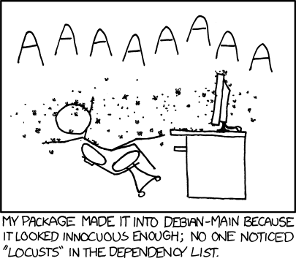
Permanent link to this comic: https://www.xkcd.com/797/
Notes:
But someone always ends up getting bit; either the developer or user.
And there are arguments for both sides as to who we should put the burden on,
But, ultimately, I think we all need to do our part, because solving dependency hell is a collaborative effort.

Slide 17
TL;DR: What can we be doing as a community?
Commit your lockfiles
Document your API’s + use semantic versioning
(see semver.org)
Communicate to your library authors when dependencies go out of date.
Provide your feedback to the package management maintainers
Notes:
So what are some things we can be doing as a community… ^

Slide 18
Without requirements or design, programming is the art of adding bugs to an empty text file.
Notes:
Before I end my talk, I want to share two parting thoughts...

Slide 19
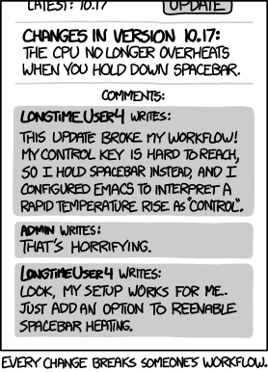
Hyrum's Law
With a sufficient number of users of an API, it does not matter what you promise in the contract:
all observable behaviors of your system will be depended on by somebody.
The End.
:q!
Permanent link to this comic: https://xkcd.com/1172/

